Slide 1
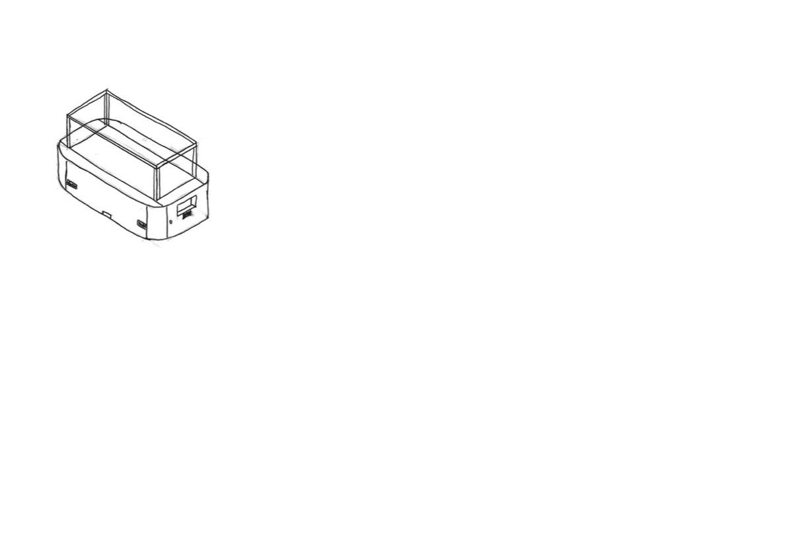
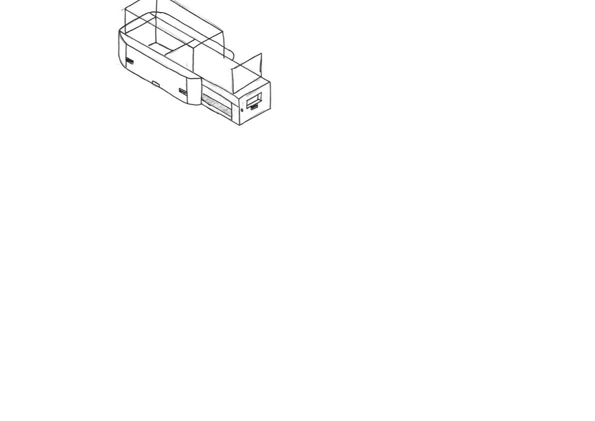
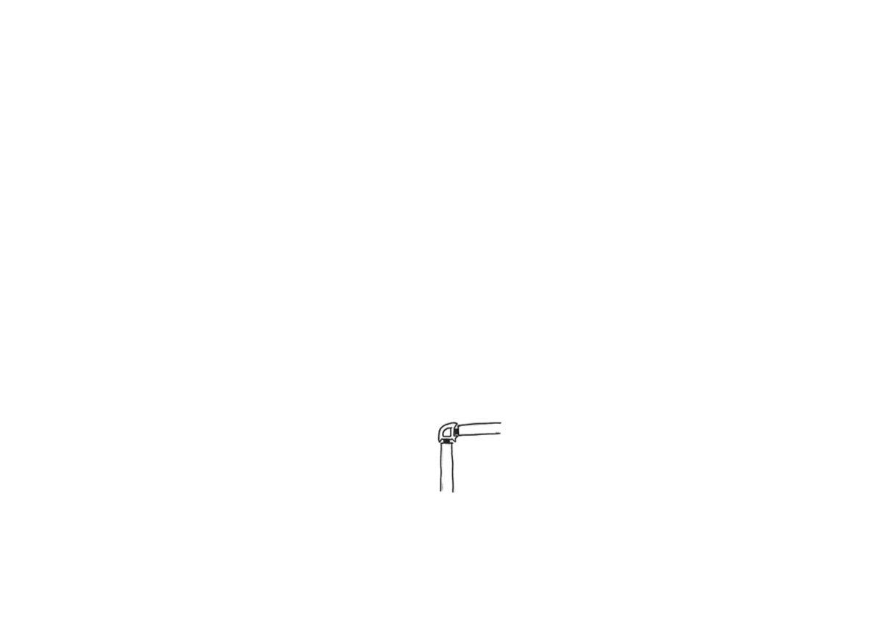
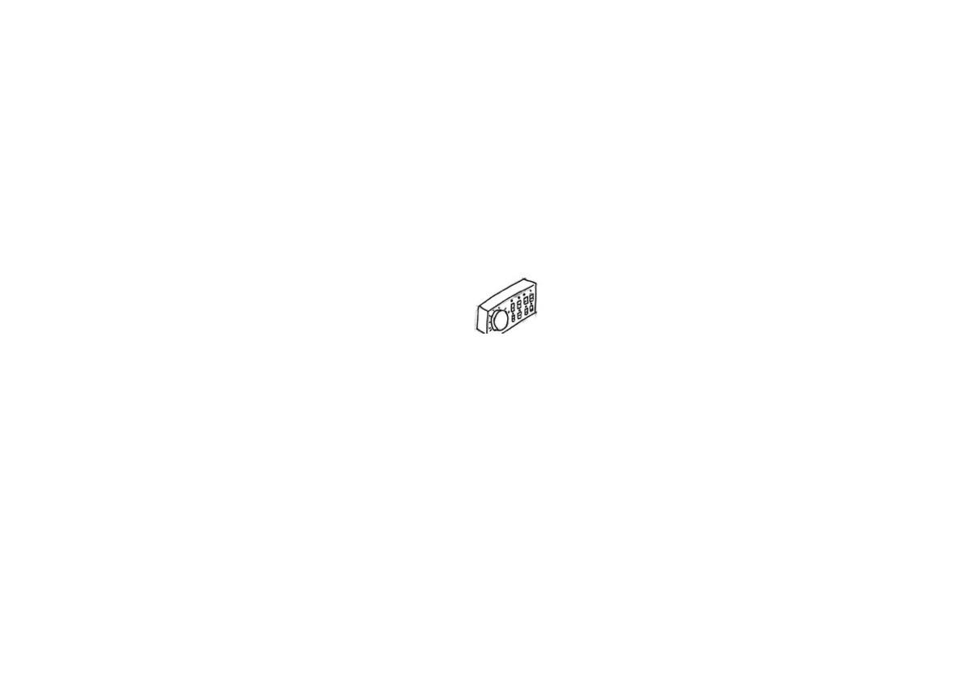
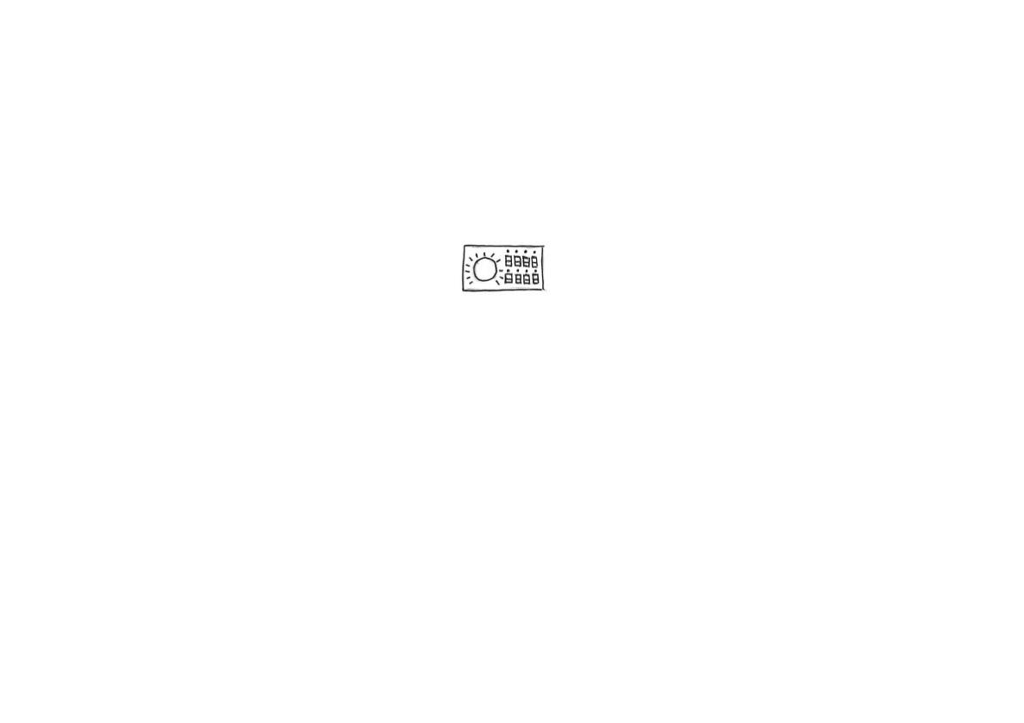
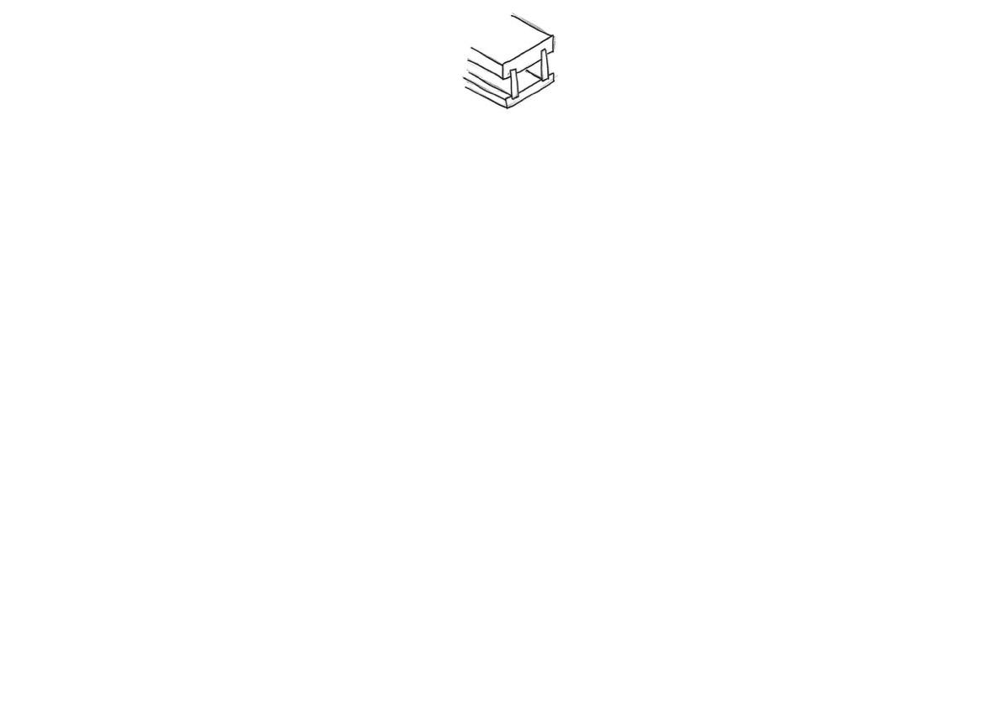
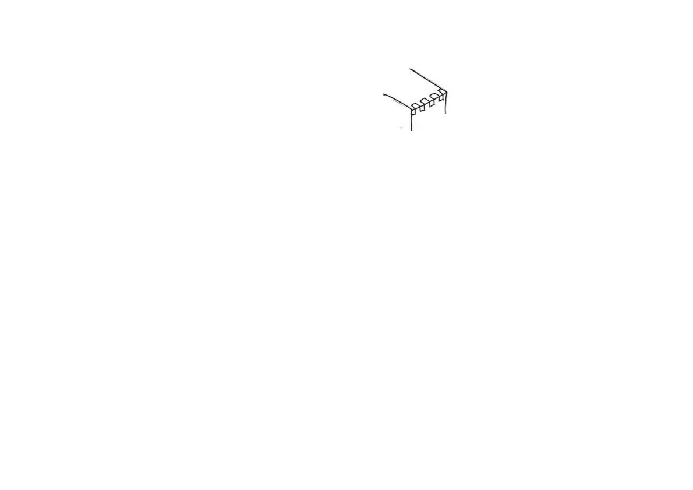
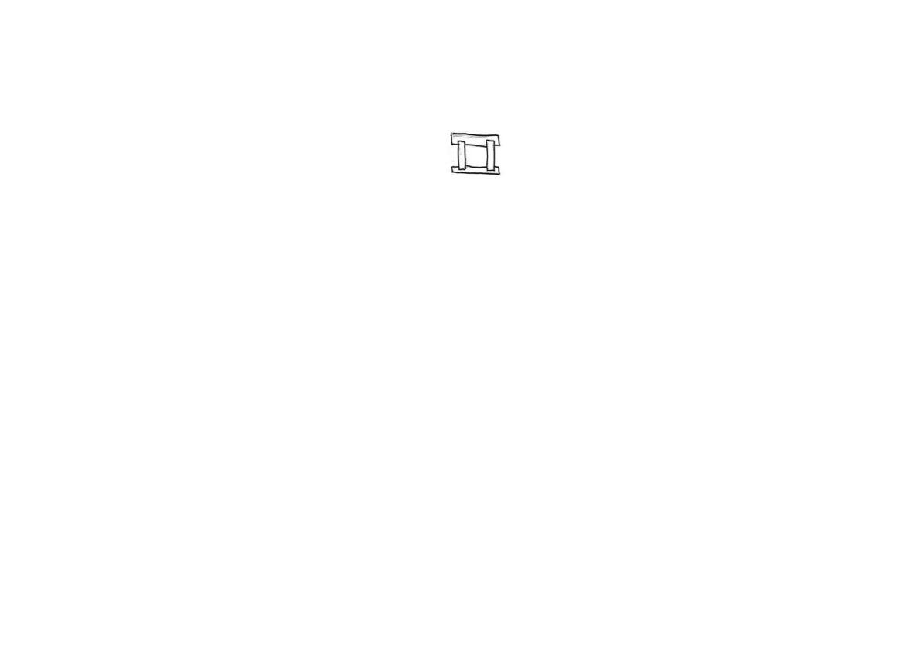
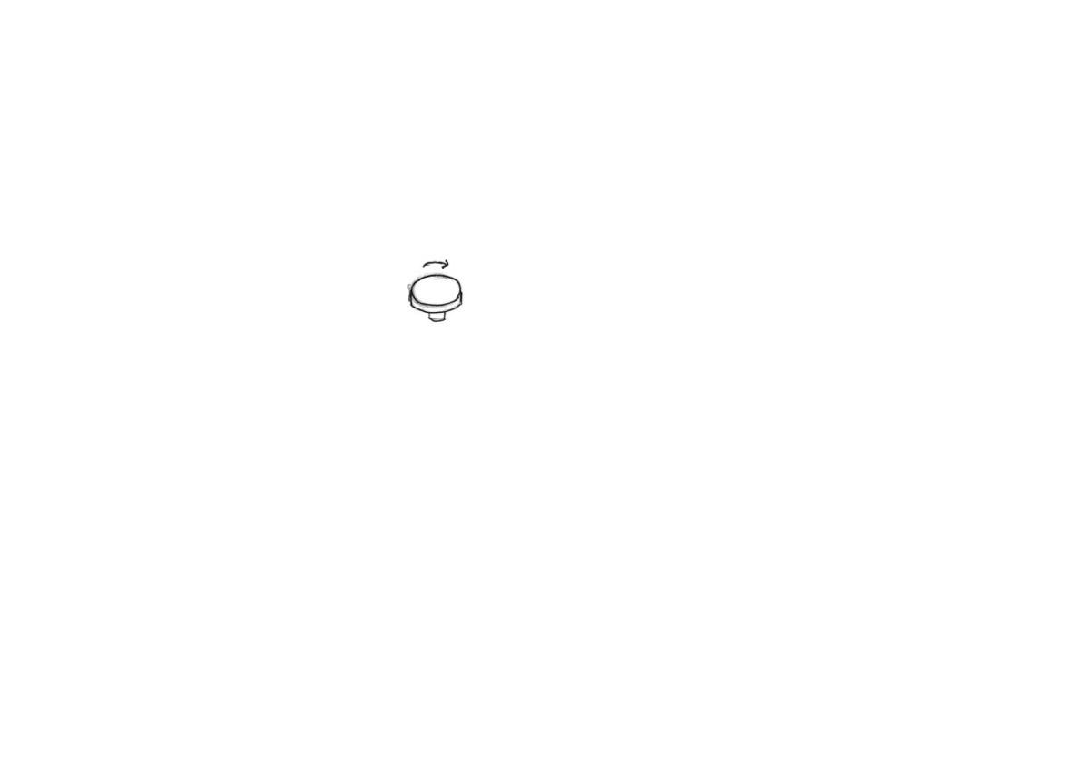
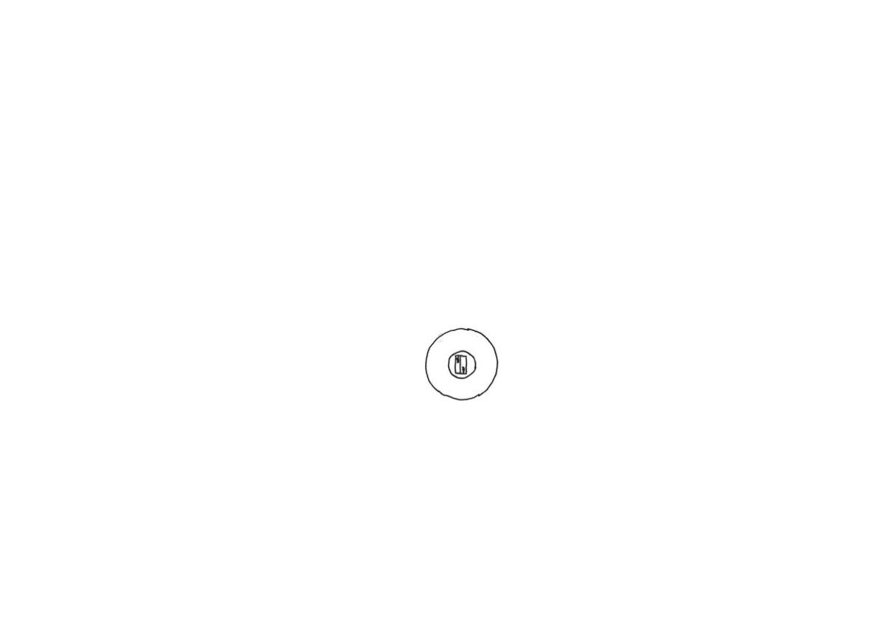
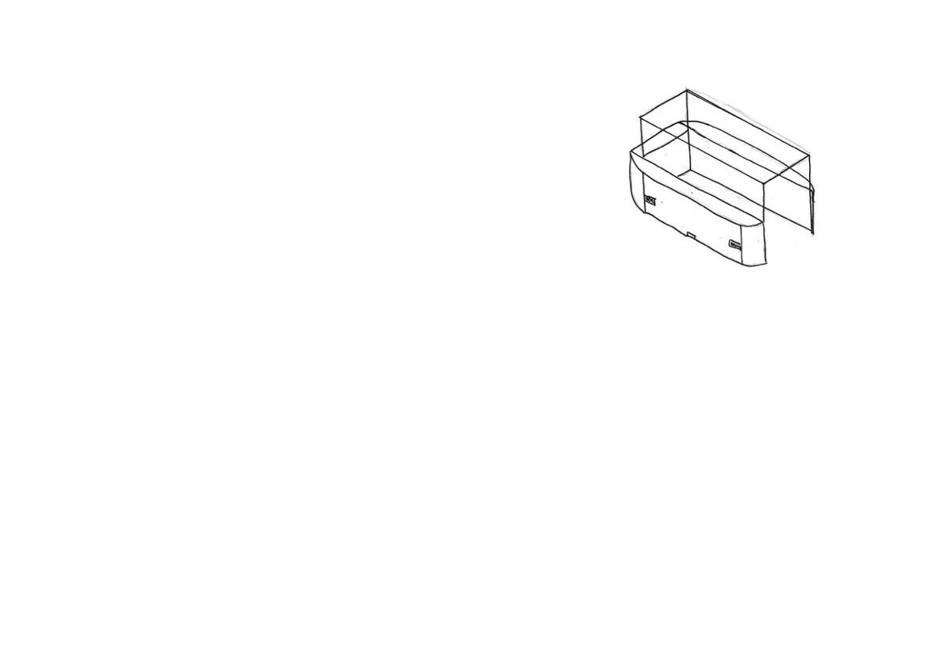
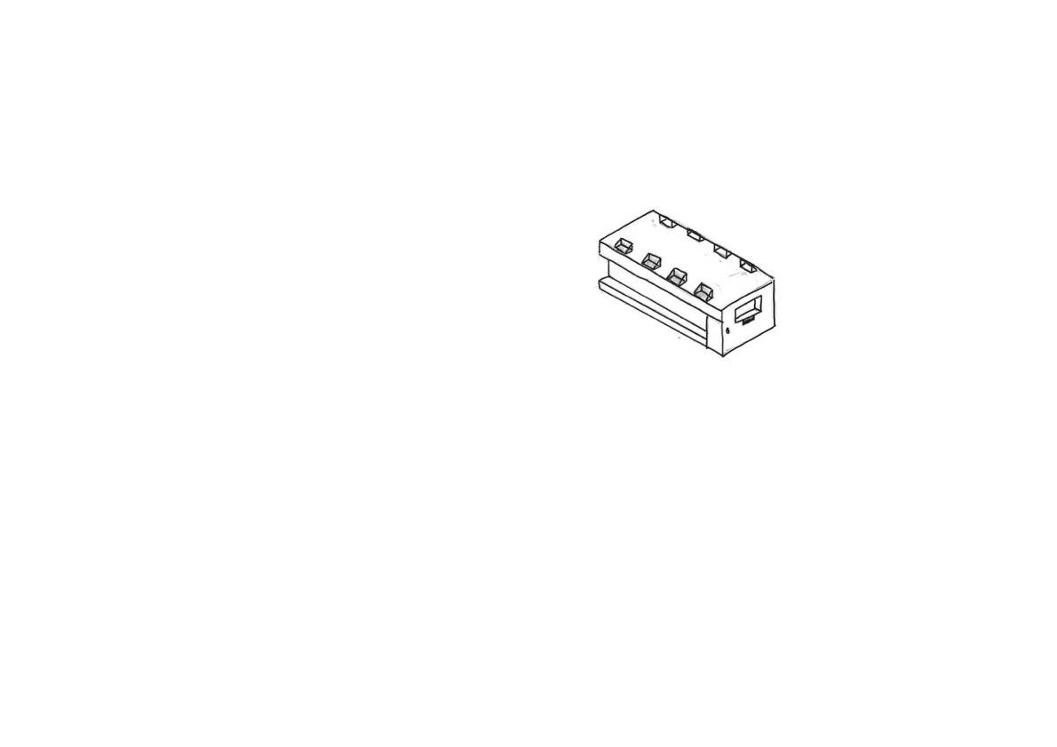
The smooth corners would be made from steam bending and then sanded down to give it a nice finish.
This is the button panel, it will not only contain the buttons but also the Arduino chipboard, to control the lights on or off via communicating to the RTC attached next to it and the motion sensors, to turn the lights and spinners off if no one is around, as requested by the design specification to reduce energy consumption.
The button panel will contain a potentiometer knob to control speed of motor. And ON/OFF switch to control whether lights are on or off.
An option for this design is that the glass panes can be joint by Glass-to-Glass steel partitioning joint
Design 1
Parts of the controller would be 3D printed. In the inside would consist of a circuit board that links to the motion sensors. An RTC would also be in here to know what time it is, and whether to turn the lights on or off
LSH, RSH, Front and Back contains 6 PIR motion sensors in total to reduce power usage.
This cabinet will be powered by mains electricity. Connected via an extension cable, and then the AC current is converted to safe 5V DC via a power adapter
Display mechanism contains a door lock to prevent theft, to provide a secure display environment for the artifact as mentioned in specification.
The wood section would be made of rubberwood to provide its integrity and joint by finger joints on its corner section. Depending on its complexity, mitre joints could even be used. And the wood section needs to be painted black as per requested by the specification.
This design consists of a drawer mechanism to access it’s inside, so it would be easier for the user to arrange the product he/she wants to put on display.
The part that slides open and closes would needs to be joint via strong housing joints. PVA glue will be used as the adhesive.
The spinner would be powered by DC electricity. A low speed high torque DC motor will be responsible for the spinning, as DC motors are save and don’t pose a risk of electrocution.
An option for this design is that the glass or acrylic panes can be joint by Silicon glue or UV glue.
The rubberwood will be covered by black veneer or black paint for aesthetic purposes. Clearcoat spray paint could be applied afterwards too.
The display side contains 8x LED lights connected to a microcontroller, ie Arduino chipboard which would be close to he button panel, which will control whether the lights are on or off.
The flat bit of the display spinner can be laser cutted with an SVG file, laser cutted acrylic have a smooth surface, and the colour could be black, giving it a minimalistic modern feel.
The display spinner’s motor flange can be 3d printed, which will then lock tightly onto the motor’s axle, allowing the spinner to spin. The flange will then be glued onto the display spinner as shown here.
Bottom side consists of railing for the drawer mechanism to slide open and close.
Notes:
Draw details on glass joints.

Slide 2
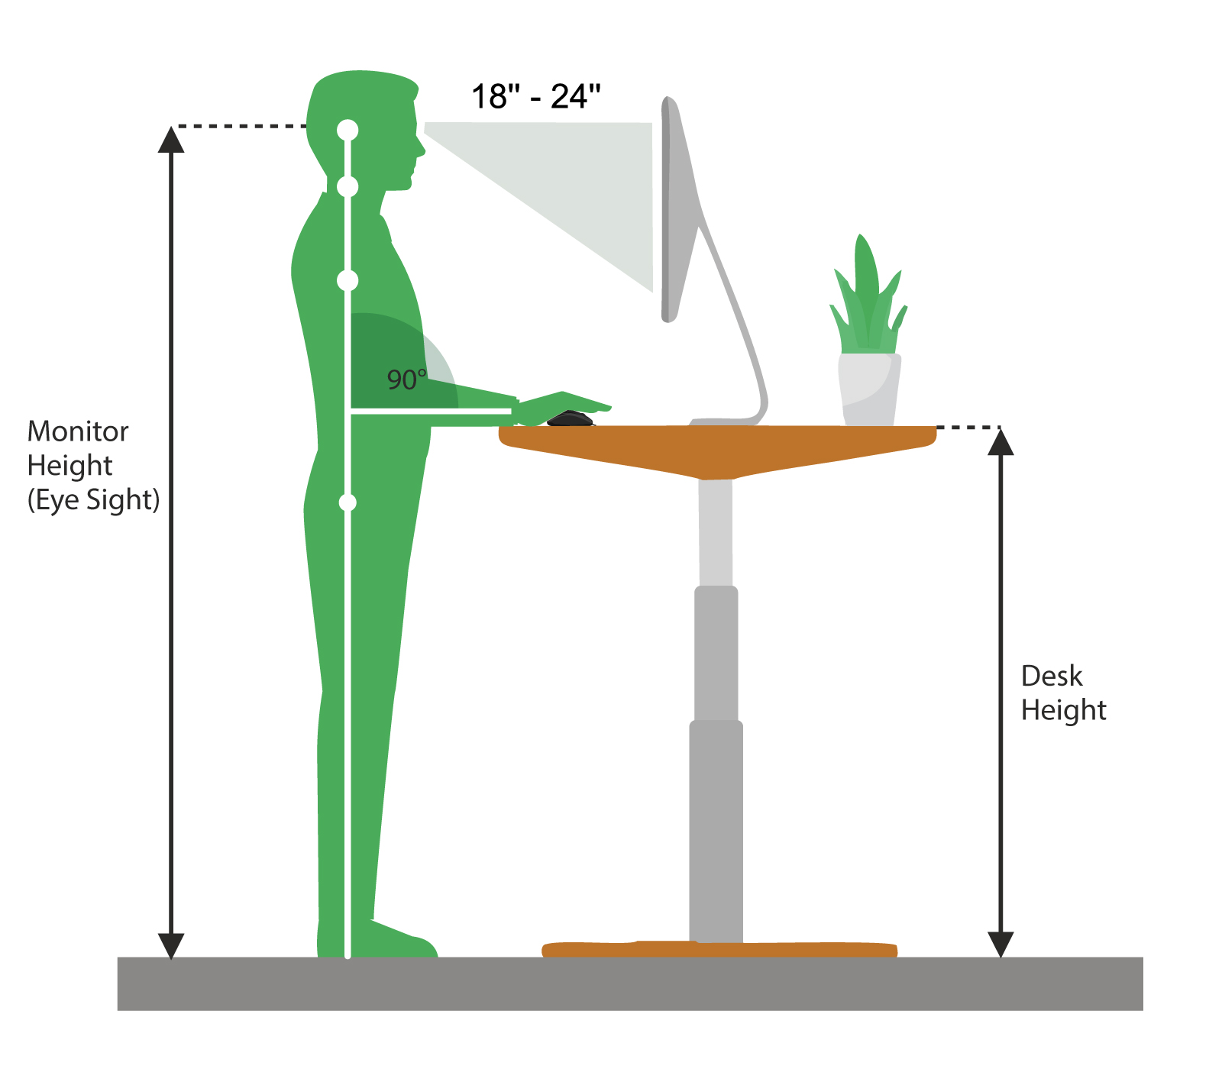
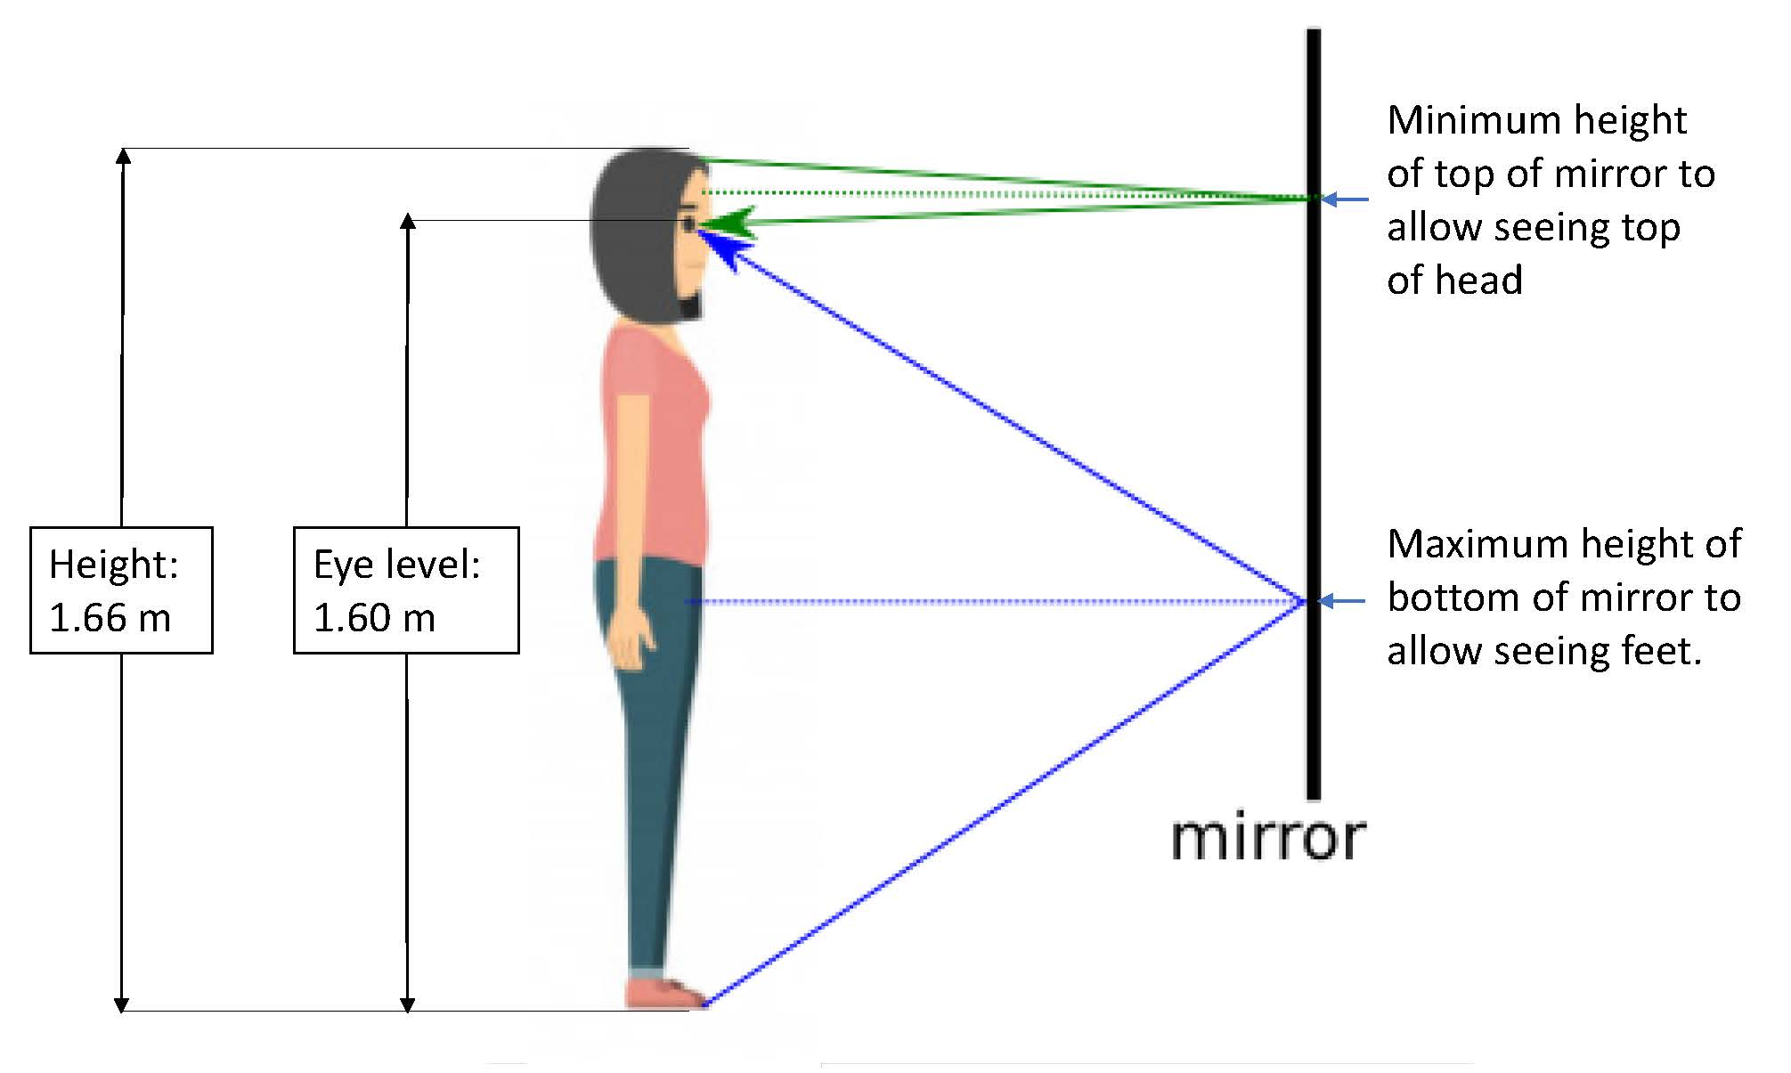
Design 1 – Development
120 cm
145 cm
500 cm
145 cm
250 cm
Since the displaying artifact needs to be at a height of 145 cm from ground, from here using the scales of this sketch, I have worked out what the dimensions of this design would approximately be.
Which, from the estimation above, the case will likely have a dimension of 5m X 2.5m X 2.65m.
For the height of this design, based on my research, which shows that eye level:height ratio is 1.04:1. Which if this display case were to be designed for world mean height of 167 cm, with an eye level of 160 cm. Further since humans tends to view things best from an angle between head tilt of 18-24 degree. Assuming that the person is standing 1 feet away, the displaying artifact needs to be at a height of 146 cm - 151 cm. Thus, in this design phase, I will assume that the height of the artifact displaying needs to be 145 cm from ground, from here I will use my drawing to estimate the dimensions of this design.
Glass-to-glass steel partitioning joint, or UV glue, or acrylic will be used to join the acrylic/glass panes together.
Wood section will incorporate mitre joints.
Overall, from the approximation drawings on this page’s top right, this means that the 5 respective pieces of glass/acrylic panes used will have a dimension of (assuming that the glass panes are 10 cm away from each respective edge):
480 cm X 120 cm (2x middle piece)
230 cm X 120 cm (2x middle piece)
480 cm X 230 cm (1x top piece)
From this information, I will determine whether is glass or acrylic suitable to be used for this design.
Each of these round, curved corner will be utilising steam bending.
Notes:
Draw details on glass joints.

Slide 3
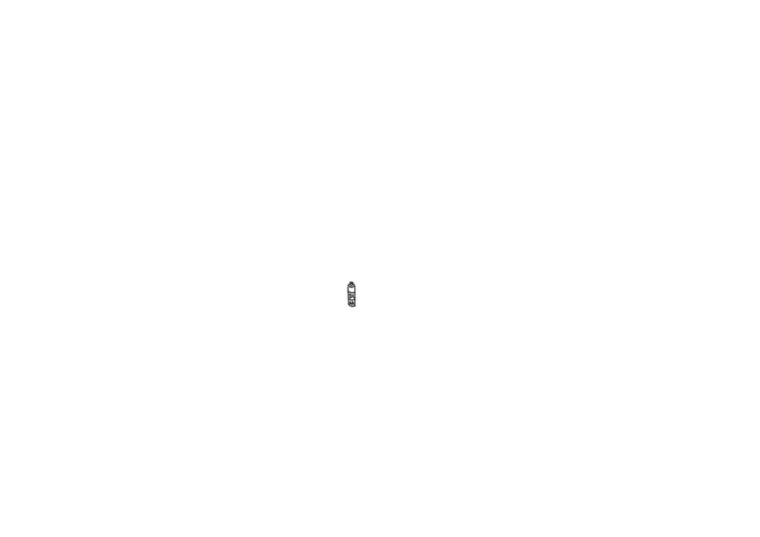
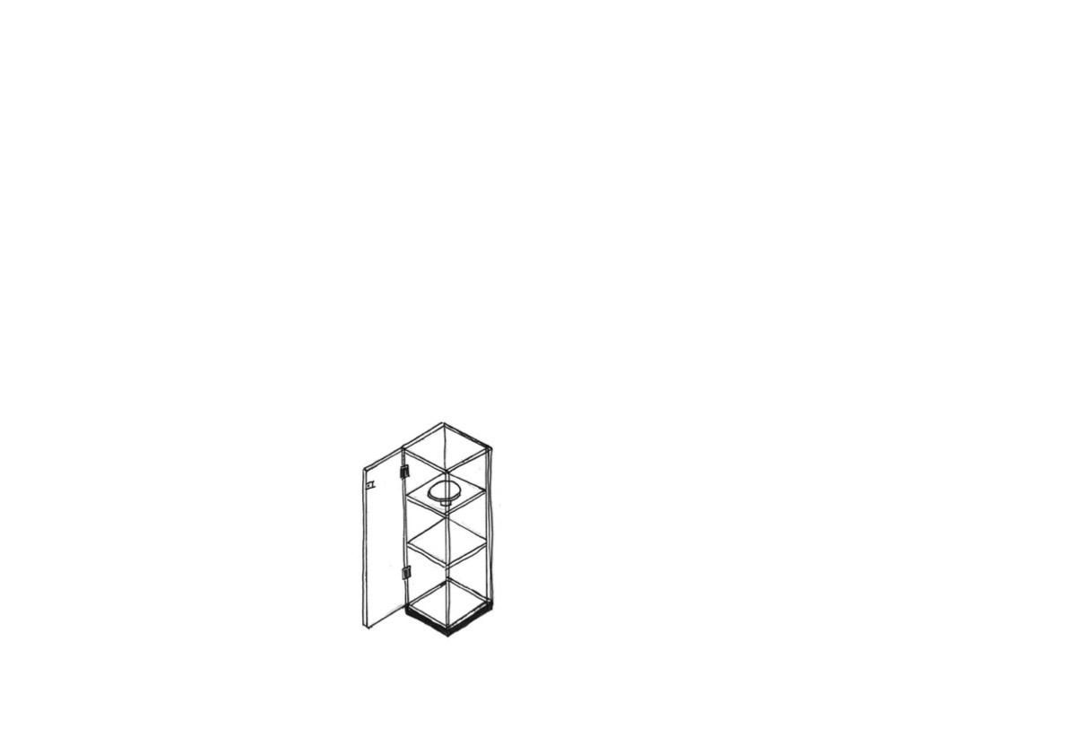
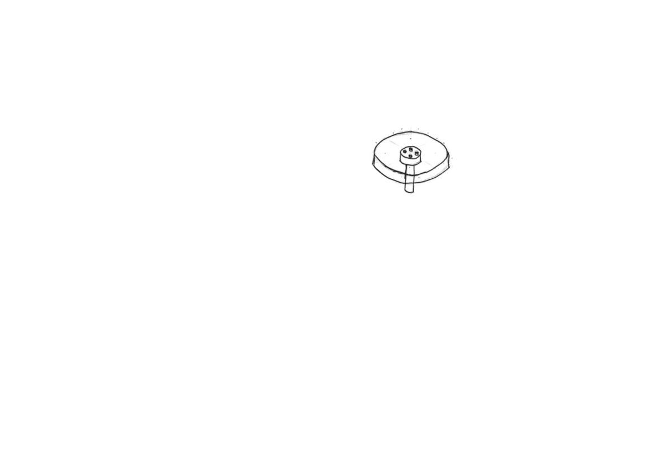
Design 2
The spinner would consist of a custom-ordered low power rating DC motor. Powered by 2x AA sized batteries. Alternative design could be that the motor is linked to wiring and batteries wouldn’t be needed. Making it more practical as the museum owner do not have to change the spinner’s battery ever so often. The chip will turn off the motor from spinning and the LED light strips to reduce energy consumption as requested by the specification.
This display spinner’s RTC and arduino chip board will be placed below the electric motor, and right above the battery holders. RTC will tell the arduino what time is it, so that the lights will be turned off during sleeping hours as mentioned in specification.
The flat bit of the display spinner can be laser cutted with an SVG file, laser cutted acrylic have a smooth surface, and the colour could be black, giving it a minimalistic modern feel.
At the top of this design, will consist of 4x PIR motion sensors, they will be pointed down and detect whether are there people around, these sensors will then communicate to the Arduino chip in the display spinner via copper wires which travels down the 4 metal rods on each corner.
However if the display spinner is powered by battery, this means it would be fully removable, so the user can choose whether to use the display spinner or not.
The display spinner will be able to carry displaying artifact and spin 360 degree as per requested by the specification. The speed needs to also be variable, and can be controlled by a remote control.
The glass door would be joint by steel hinges.
In between each glass pane layer, LED strips could be installed to provide lighting for the displaying artifact, variable resistor could even be installed to control the brightness to the user’s needs. LED is specifically used as they are efficient and doesn’t waste much power unlike incandescent bulbs.
The display spinner’s bottom bit will be a motor axle, which will be held together by a 3D printed motor flang and locked tightly to the motor axle, so the spinner will be spun.
In this design, there won’t be a button panel to control the ON/OFF of the DC motor and LED light strips. Instead, this design will rely on a remote control, which a bluetooth component needs to be installed.
Glass doors contain door lock to prevent theft.
The sides of this design would compose of 4 stainless steel or iron rods, that will give this design structural integrity, which the individual glass pieces will then be attached to the metal rods via glass-to-glass steel partitioning joints.
This design consists of glass panes for its outer panels to give it a minimalistic look.
Concept of motor flange. Which will be glued to the motor’s axle and display spinner.
This design have 2 glass panes in between, which will be held together by the 4 corner metal rods, these 2 panes acts to give this design 3 layers in between o display.
Bottom section would be made of custom-made aluminium block, which I will then drill out 4 holes on each ends to fit through the 4 supporting steel rods.
Silicone will be use as the adhesive to join the steel and glass together. Silicone is extremely strong and will hold the side glass panes together well.
The copper wires will run through these 4 metal rods, connecting the motion sensors at the top and the display spinner on the top layer, to provide these electronic components with a supply of electricity.
The corner of the glass panes on this design would be held up by custom-ordered glass-to-glass steel partitioning joints.

Slide 4
Design 2 – Development
70 cm
145 cm
145 cm
70 cm
70 cm
Since the displaying artifact needs to be at a height of 145 cm from ground, from here using the scales of this sketch, I have worked out what the dimensions of this design would approximately be.
Which, from the estimation above, the case will likely have a dimension of 0.7m X 0.7m X 2.15m.
For the height of this design, based on my research, which shows that eye level:height ratio is 1.04:1. Which if this display case were to be designed for world mean height of 167 cm, with an eye level of 160 cm. Further since humans tends to view things best from an angle between head tilt of 18-24 degree. Assuming that the person is standing 1 feet away, the displaying artifact needs to be at a height of 146 cm - 151 cm. Thus, in this design phase, I will assume that the height of the artifact displaying needs to be 145 cm from ground, from here I will use my drawing to estimate the dimensions of this design.
Glass-to-glass steel partitioning joint, or UV glue, or acrylic will be used to join the acrylic/glass panes together.
Overall, from the approximation drawings on this page’s top right, this means that the 7 respective pieces of glass/acrylic panes used will have a dimension of:
215 cm X 70 cm (4x middle panels)
70 cm X 70 cm (top & 2x layer panels)
From this information, I will determine whether is glass or acrylic suitable to be used for this design.
For the base, an alternative to rubberwood used can be stainless steel, which will give this design a minimalist look, and can even be spray painted if requested by the client.
Notes:
Draw details on glass joints.

Slide 5
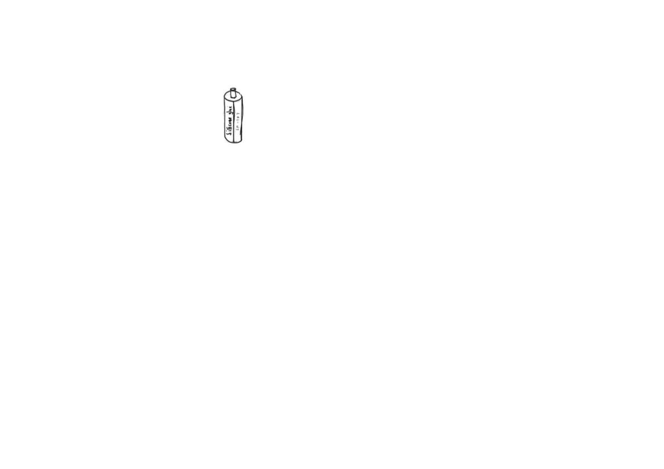
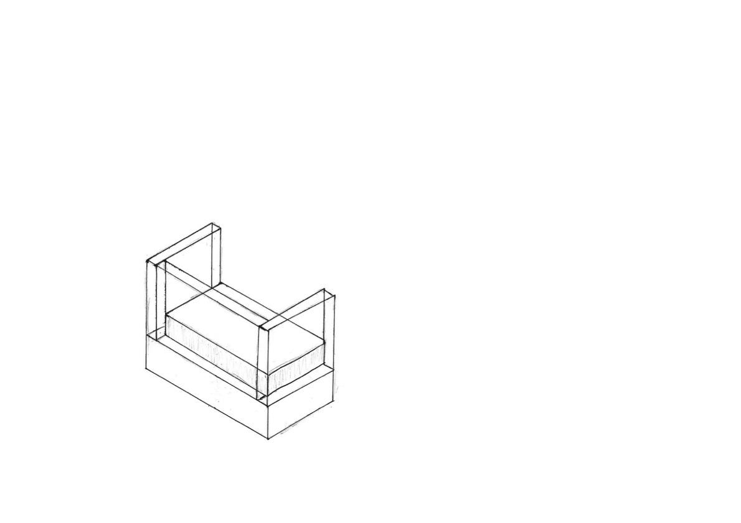
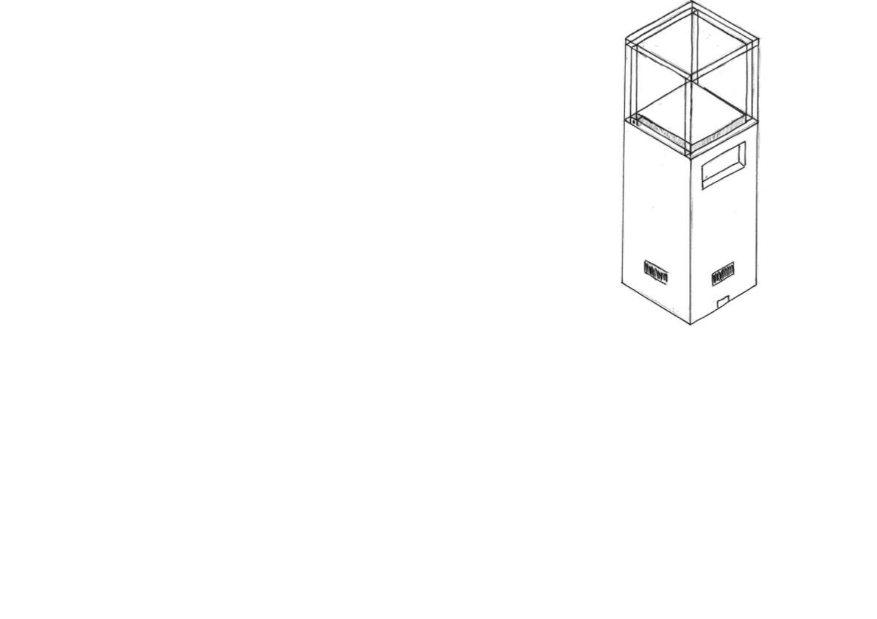
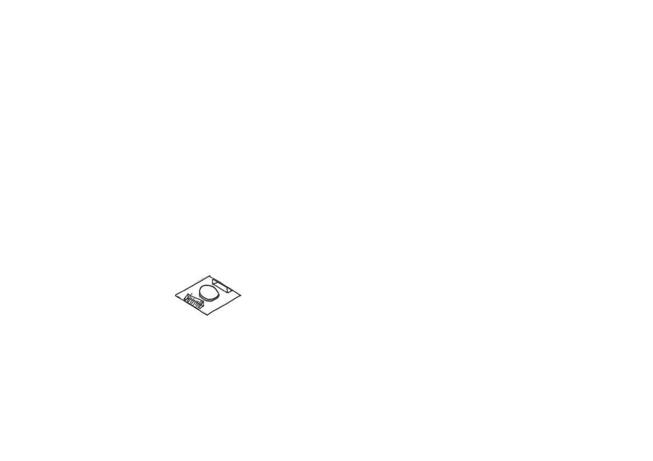
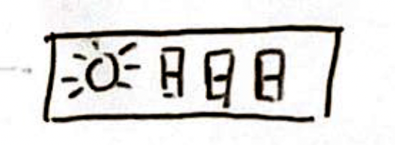

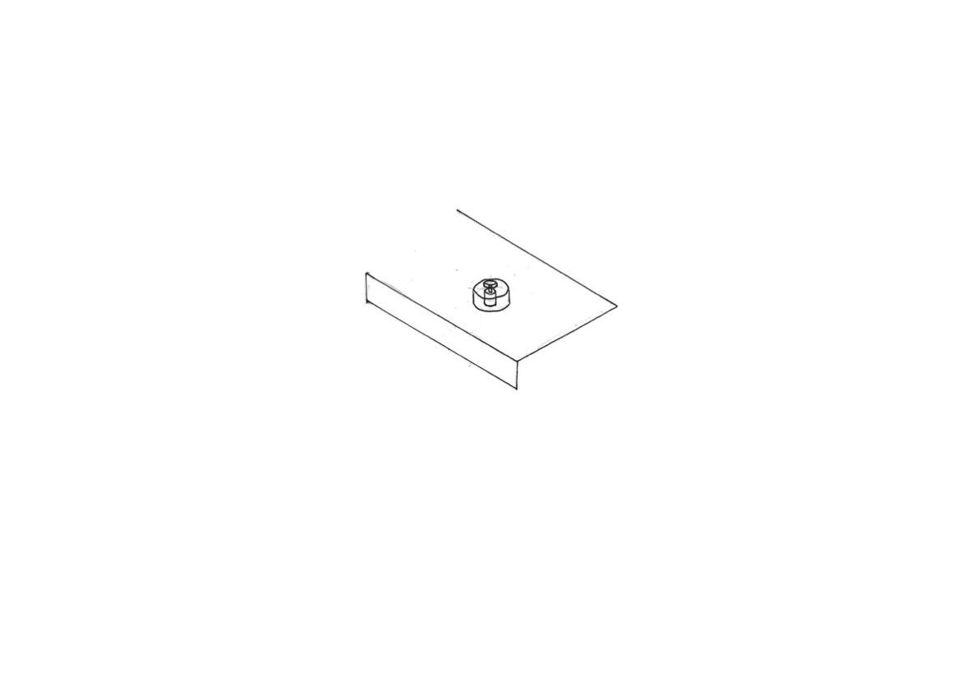

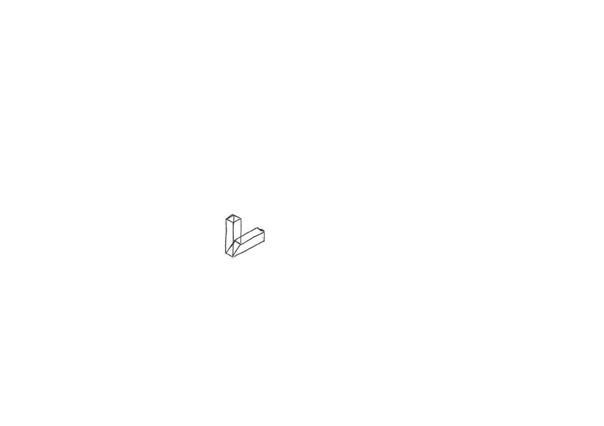
Design 6
The top bit, needs to be transparent in order for viewer to see through it to observe the object which is displaying. This part will likely be made of acrylic or glass. Chloroform would be used if acrylic, and UV glue or silicone could be used if glass is used in this part.
Lock mechanism to prevent theft.
Silicone will be use as the adhesive to join the steel and glass together. Silicone is extremely strong and will hold the side glass panes together well.
This section is where the LED lamps and display spinner will sit on, which this square area will consist of the display spinner and 2 LED lamps. LED lamps are used as they wasted 85% less energy than incandescent lamps, higher energy efficiency, as stated in the design specification, to reduce energy consumption overall, reducing carbon footprint.
An alternative to glueing the pieces of glass panels or acrylic together directly could be to use glass-to-glass steel partitioning joint.
In this design, the transparent bit, or the acrylic case will be an independent bit, sort of 5 acrylic face panels glued together, this means the case wouldn’t be directly attached to the main display case. So, in order to hold the acrylic section in place, I will likely need to create a change in height, which will act like a track for the acrylic section to sit on. A good reason for acrylic instead of glass used here is that acrylic is fairly light, which means its more easily removable, making maintenance and installation much easier for the museum worker to clean or change the displaying artifact, as stated in the design specification.
This is where the button panels are located in this design. The button panel will control the speed of which the motor is spinning, and whether the lights in this sphere display case is on or not. The RTC and Arduino microcontroller will be placed behind this button panel. The RTC will tell the Arduino to turn off the lights and motor off during closing hours to further reduce energy consumption, as stated in the specification.
This design will incorporate 4 motion sensors, 1 on each side, to detect motion to know when to turn the LED lights and DC motor on or off. Components are turned off when no one is around in order to reduce energy consumption as stated in the specification.
A lock mechanism needs to be incorporated to prevent unauthorised access/touching/theft of the displaying artifact. The display case needs to aim to give the displaying artifact a safe and secure environment to display in.
This is where the extension cable will be inserted, to supply electricity to all respective electrical components in this design. Mains electricity will be converted to 6V DC for safety purposes, to prevent risk of death from electrocution as mentioned in specification
The bottom half of Design 5 will be made of rubberwood, and then painted black and sprayed clearcoat, as requested by the respondents in the survey I’ve conducted.
Inner section will be hollow to reduce weight of this design to allow ease of relocation and moving around, as mentioned in specification.
The flat bit of the display spinner can be laser cutted with an SVG file, laser cutted acrylic have a smooth surface, and the colour could be black, giving it a minimalistic modern feel.
Cross section of how the motor will be placed in order to connect to the motor flange and display spinner. Display spinner will spin the displaying artifact 360 degrees to give the viewer a great viewing experience as the exclusivity of the artifact is emphasised as mentioned in the specification.
Like design 5, Design 6 will incorporate Mitre joints for the main rubberwood panels. Based on my research on wood joints, the usage of mitre joints for wood panels at this size is likely to be easier.
Ergonomic Note
The height of this design needs to be appropriate and ergonomic, in such that the user can easily observe/view the displaying artifacts in the display section without having to tiptoe or bend over, as mentioned in the specification.
The display spinner’s bottom bit will be a motor axle, which will be 3D printed and locked tightly to the motor axle, so the spinner will be spun.
Notes:
Door lock. Crop out finger joint horizontal. Flange coupling

